Slide 1

The Pulse of Cement: Analyzing Macroeconomic Influences

Slide 2
The Pulse of Cement: Analyzing Macroeconomic Influences on Production & Sales
Customer Personality Analysis Project - Data Visualization & Storytelling
[Your Name] - Data Analyst Intern

Slide 3
Understanding the Cement Industry's Drivers
Challenge
Objective
Goal
The cement industry is foundational to infrastructure and development, but its performance is highly sensitive to external economic forces.
To identify and visualize how key macroeconomic indicators impact cement production, sales, and demand.
Provide data-driven insights to better understand market dynamics and inform strategic planning.

Slide 4
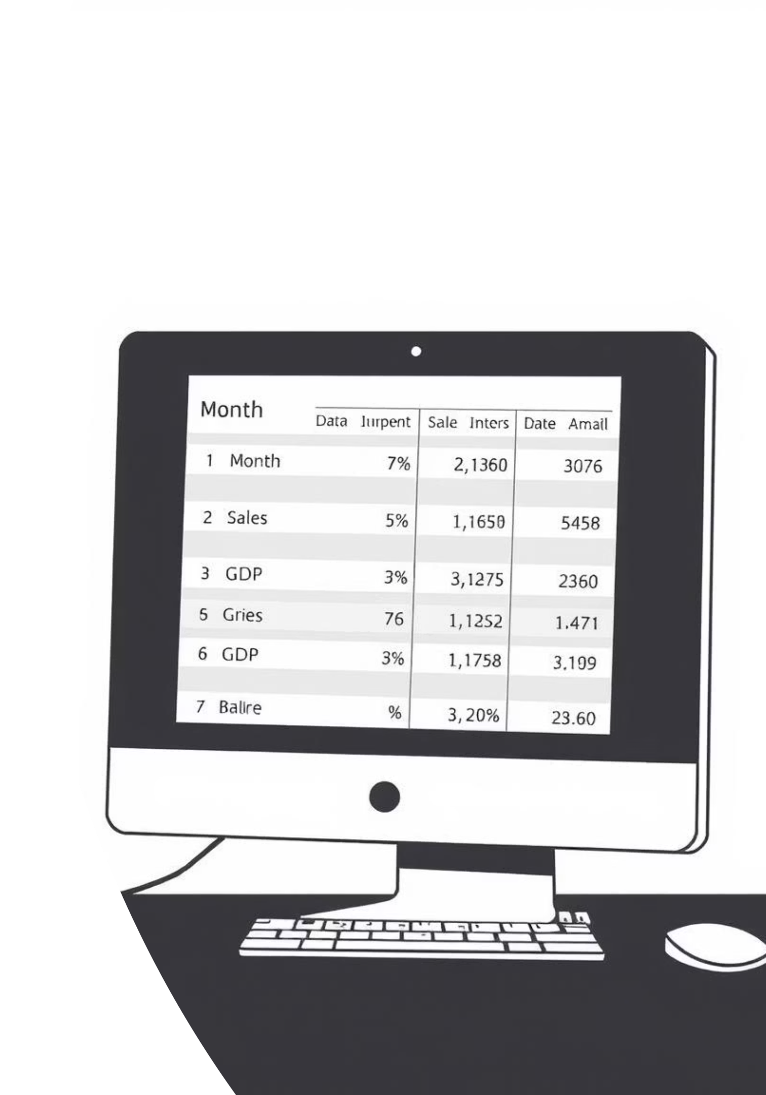
Our Data at a Glance
The Dataset: What We're Working With
Source: 89cement data.csv
Key Variables:
Timeframe: Monthly data over a significant period.
Month: Time series indicator.
Initial Preparation: Data cleaning performed in Power BI's Power Query Editor to ensure accuracy and consistency.
Production: Monthly cement production volume.
Sales: Monthly cement sales volume.
Demand: Estimated market demand for cement.
Population: National population figures.
GDP: Gross Domestic Product, indicating economic health.
Disbursement: Government or other financial disbursements.
Interest rate: Prevailing interest rates.

Slide 5
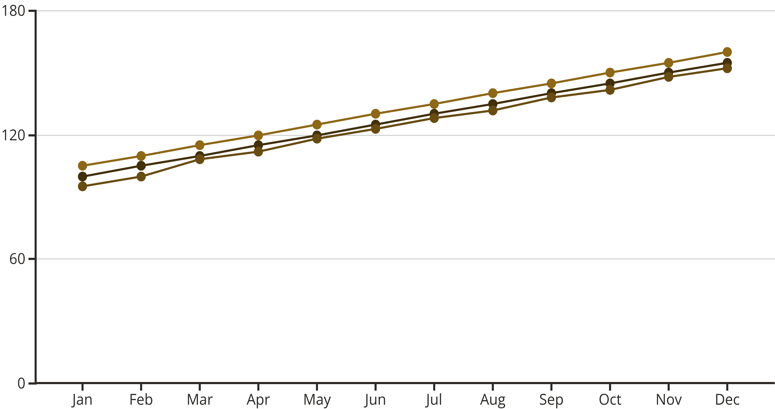
Cement's Rhythmic Flow: Monthly Trends
Production
Sales
Demand
Story: Observe the cyclical patterns and overall trajectory of the cement market. Are sales consistently meeting demand? How does production react to changes in demand? Are there seasonal fluctuations?
Insight: This chart sets the baseline, showing the core performance of the industry before we layer in external factors.

Slide 6
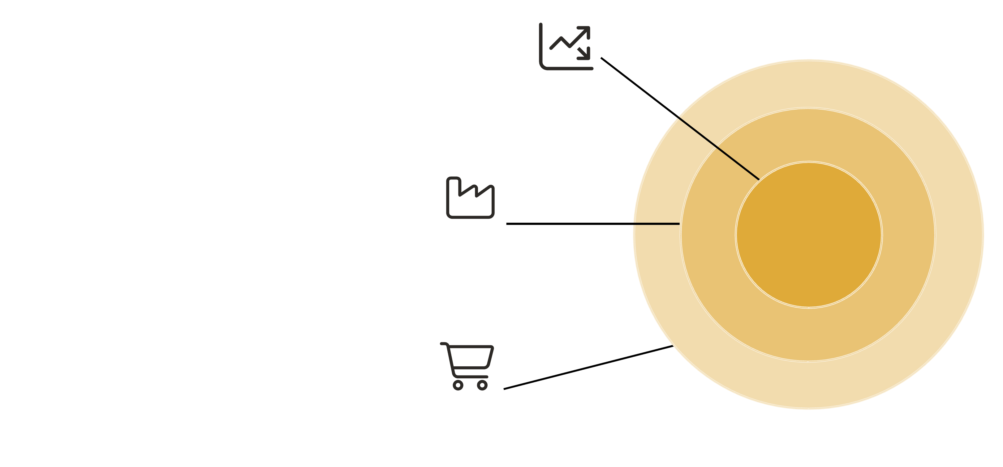



Economic Growth & Cement Activity
Country's GDP
Central focus of economic activity.
Cement Production
Output influenced by economic growth.
Cement Sales
Market demand driven by GDP levels.
Story: Explore the direct relationship between the country's economic output and the cement industry's activity. Does higher GDP correlate with increased production and sales? What is the strength and direction of this relationship?
Insight: A strong positive correlation would indicate that as the economy grows, so does the need for cement, driven by construction and infrastructure projects.

Slide 7
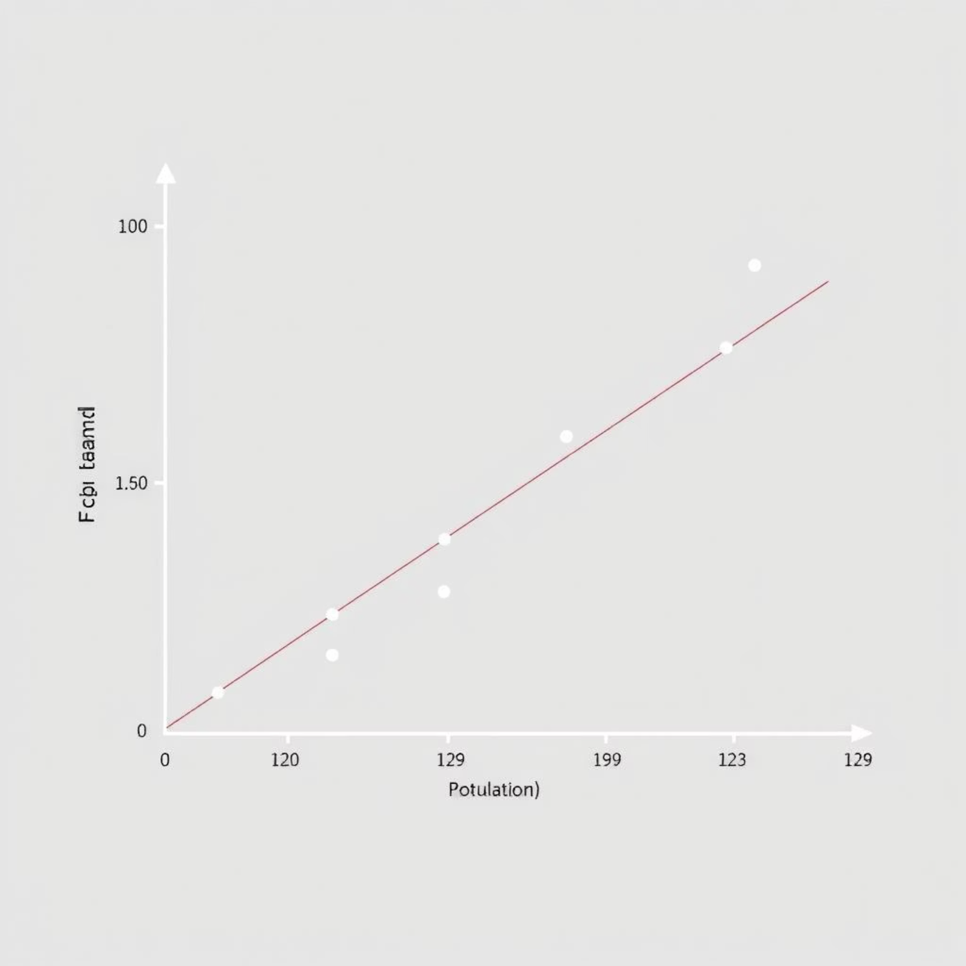
Population Dynamics & Cement Demand
Story: Investigate if a growing population directly translates into higher demand and sales for cement. Does more people mean more housing, more infrastructure, and thus more cement?
Insight: Population growth is a fundamental driver of construction, and this visualization helps quantify its direct impact on cement consumption.

Slide 8
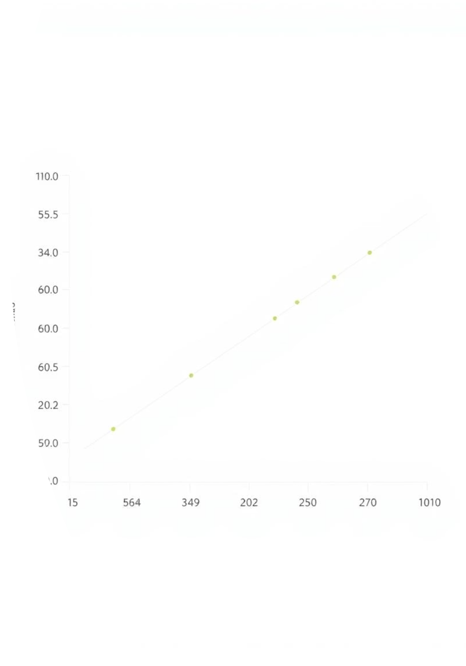
Cost of Money: Interest Rate Effects
Interest Rates & Sales Performance
Story: Analyze how borrowing costs might influence consumer and business spending on construction, ultimately affecting cement sales. Do higher interest rates lead to a slowdown in sales? Is there an inverse relationship?
Insight: Interest rates affect the cost of loans for construction projects. Understanding this relationship is crucial for forecasting sales.

Slide 9
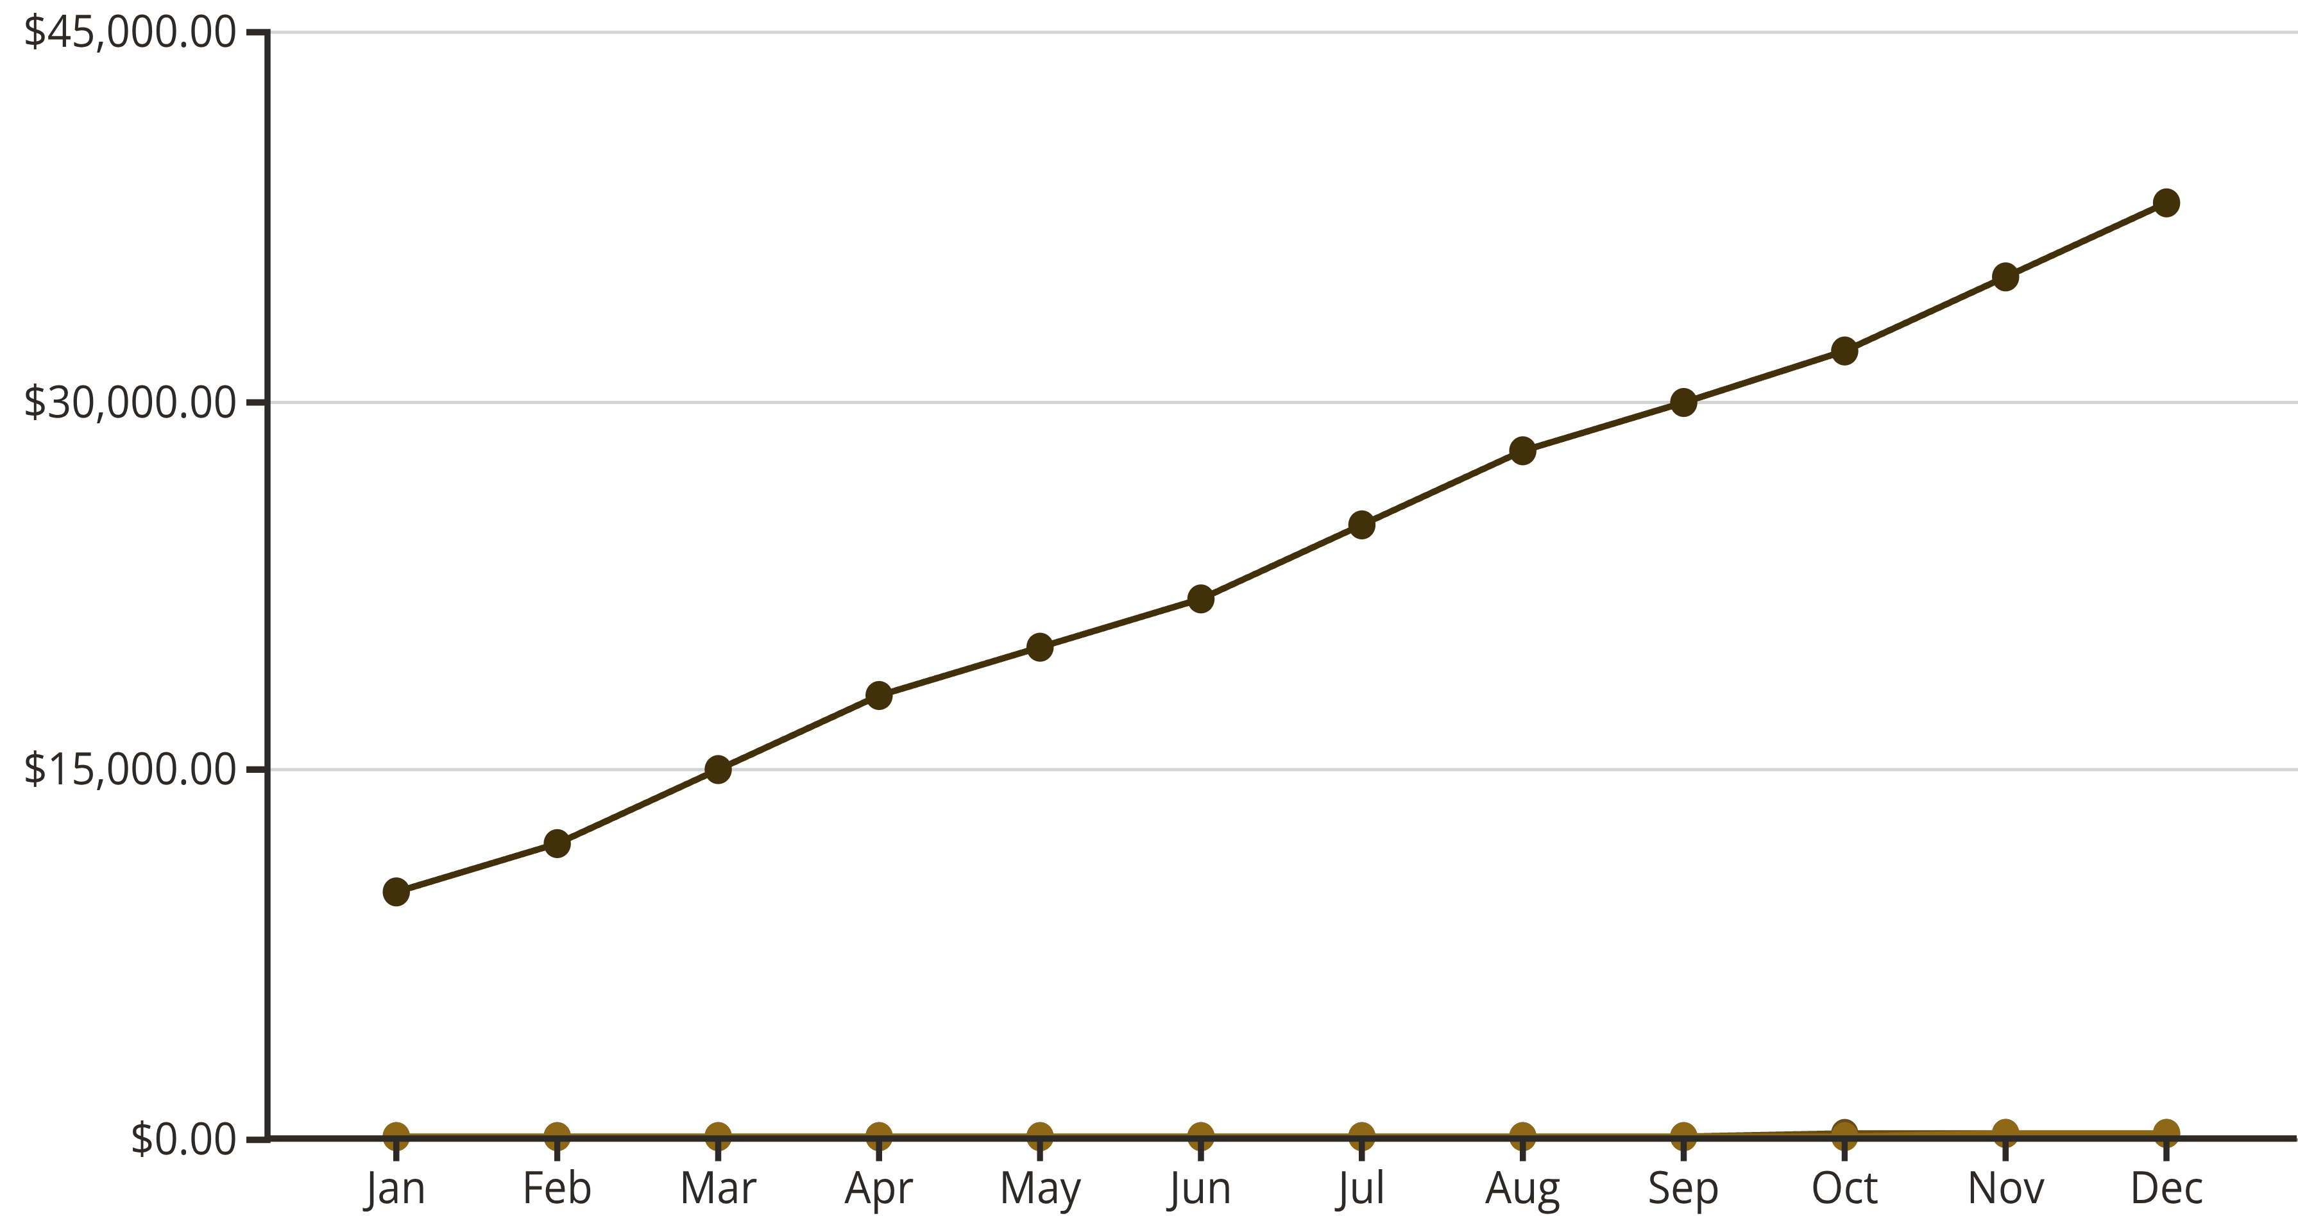
Government Spending & Industry Support
Disbursement
Production
Sales
Story: Examine if government or other significant financial disbursements show any correlation with spikes or dips in cement activity. Are there specific periods of high disbursement that align with increased production or sales?
Insight: Large-scale financial injections can stimulate economic activity, including construction, and this visual helps identify such impacts.

Slide 10
What the Data Tells Us
Strong Correlation
Cement sales and production are highly correlated with GDP growth.
Population as a Driver
Population increases generally correspond to higher cement demand, indicating consistent underlying growth.
Interest Rate Sensitivity
Higher interest rates show a tendency to dampen sales, suggesting a sensitivity to borrowing costs for projects.
Seasonal Patterns
Identified clear seasonal patterns in production and sales, likely tied to weather and construction cycles.
Data Gaps
Further analysis could benefit from more granular regional data for a deeper understanding.

Slide 11






Key Insights: Answering Questions
Trends Over Time
Correlation with GDP & Population
Interest Rate Influence
Cement production, sales, and demand exhibit clear seasonal patterns with an overall upward trajectory, suggesting consistent growth over the years.
Higher interest rates tend to dampen cement sales, highlighting the industry's sensitivity to borrowing costs and the broader financial environment for construction projects.
A strong positive correlation exists between GDP, population growth, and cement activity, indicating that economic expansion and demographic shifts directly drive industry performance.
These findings confirm the significant impact of macroeconomic forces on the cement sector, providing a robust framework for future forecasting and strategic decisions.

